Slide 1



INCARCERATION
“Injustice v Justice,
Punishment or Restoration”
October 2019

Slide 2


Our jail systems and practices play an enormous role in our communities. With the right path, we can make our neighborhoods safer; keep families together and strong; and save vital resources to reinvest in education, job training, and rehabilitation. And we can treat all who come through our courthouse doors with dignity and respect.
(Detroit News: Garlin Gilchrist II and Bridget McCormack Published 6:07 a.m. ET May 12, 2019)

Slide 3
In 2015 there were 15,328 people in Michigan’s local jails, approximately 54 percent of whom were awaiting trial.
Blueprint for Smart Justice Michigan © 2018 AMERICAN CIVIL LIBERTIES UNION

Slide 4
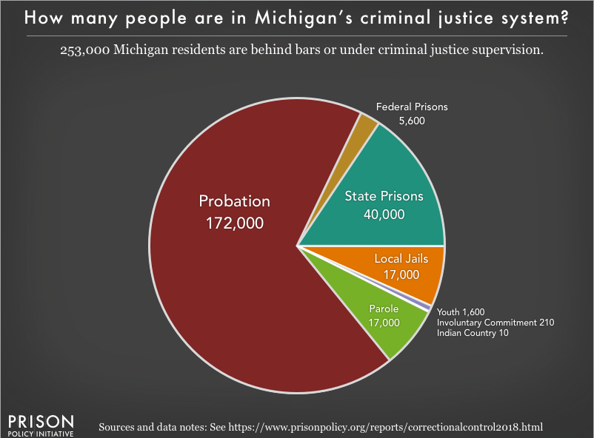

Slide 5
In 1960 Michigan counties held 51 people in jail for every 100,000 residents. In 2017 ‒ with the same crime rate as 1960 ‒ Michigan counties held 163 people in jail for every 100,000 residents.
- Bridge Magazine (July 24, 2019)

Slide 6
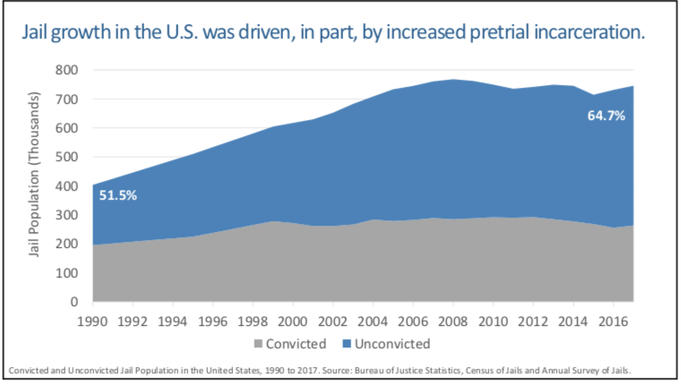

Slide 7
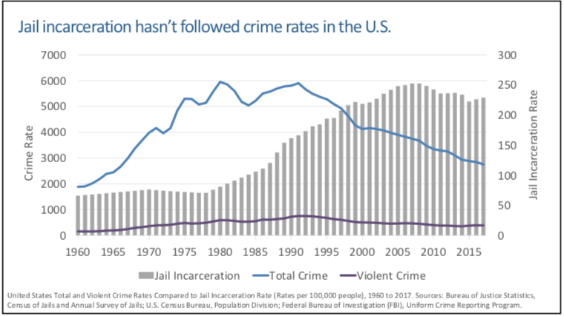

Slide 8
Michigan had the seventh-highest correctional control rate in the United States in 2015.
Blueprint for Smart Justice Michigan © 2018 AMERICAN CIVIL LIBERTIES UNION

Slide 9
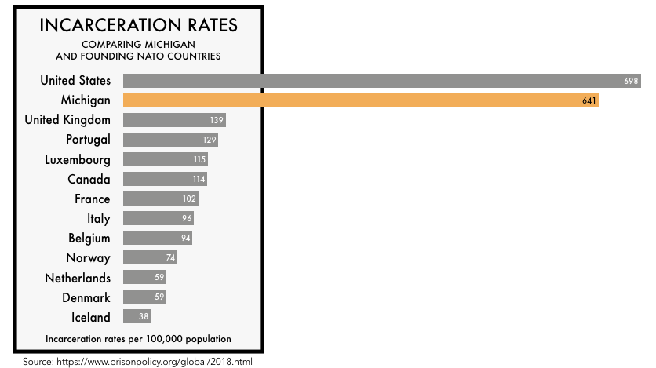
Today, Michigan’s incarceration rates stand out internationally

Slide 10
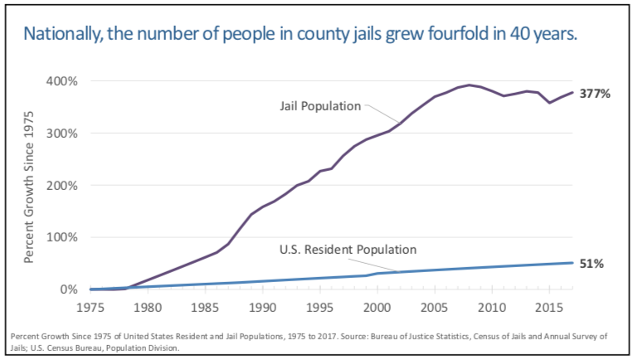

Slide 11
Michigan taxpayers sink nearly half a billion dollars each year into county jails — almost three times what they spend on community and economic development at the county level.
(Detroit News Ken Borton Published 10:50 p.m. ET July 23, 2019)

Slide 12
In 2017, Michigan taxpayers spent $478
million on county jail and corrections costs.
Source: Michigan Department of Treasury, MI Community Financial Dashboard.
Notes:
Keep it brief. Make your text as brief as possible to maintain a larger font size.

Slide 13
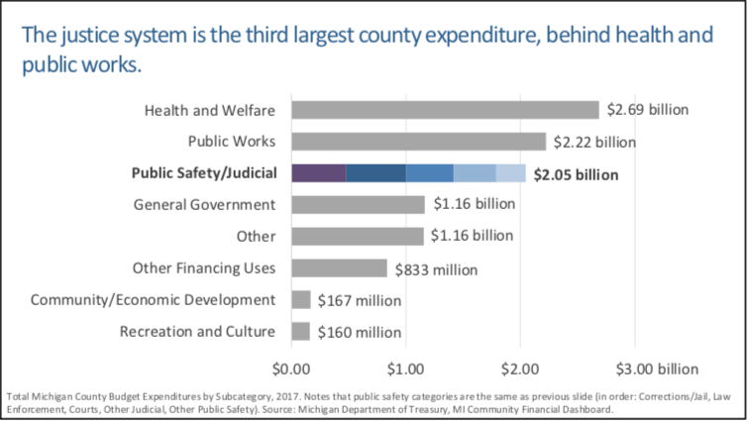

Slide 14
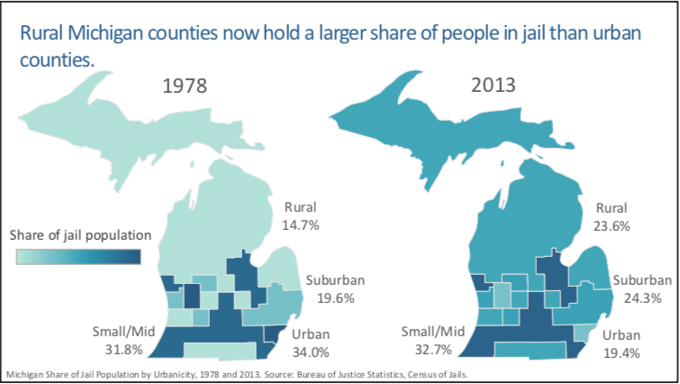
New Work

Slide 15
Grand Traverse County Jail
The jail processes nearly 10,000 individuals over the course of a year.
The central part of the jail was constructed in the mid 1960s. An extensive remodel was completed in the mid 1980s
In 2006, the Law Enforcement Center moved from the jail location which allowed for much needed beds, raising occupant capacity to 168.
(https://www.grandtraverse.org/793/Quick-Facts)

Slide 16
To end mass incarceration, Michigan must break its overreliance on incarceration as a response to social problems.
Evidence indicates that prisons seldom offer adequate solutions to wrongful behavior.
Blueprint for Smart Justice Michigan © 2018 AMERICAN CIVIL LIBERTIES UNION

Slide 17
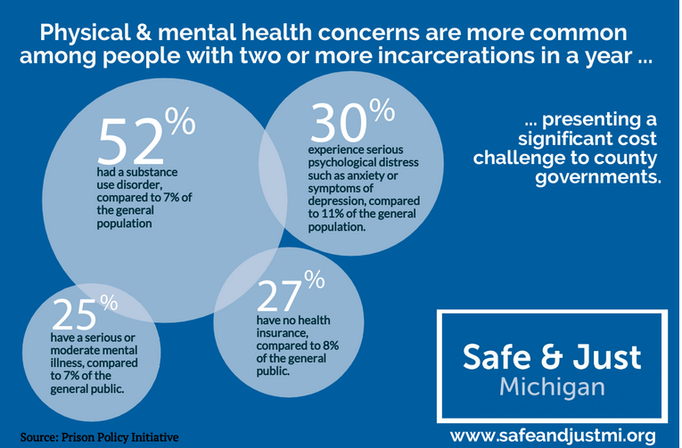

Slide 18
People showing signs of mental illness are twice as likely to be arrested as people without mental illness for the same behavior.
Blueprint for Smart Justice Michigan © 2018 AMERICAN CIVIL LIBERTIES UNION

Slide 19
75% of those in jail, whether they are serving sentences or are being held before trial, are behind bars for nonviolent traffic, property, drug, or public order offenses
http://www.safetyandjusticechallenge.org/about-jails/ Supported by the MacArthur Foundation

Slide 20
The unemployment rate for people on parole is 67 percent. Many of the 10,000 people paroled annually, even those with low-level nonviolent convictions, are legally banned from employment in many industries.
Source: https://www.safeandjustmi.org/our-work/second_chances/

Slide 21
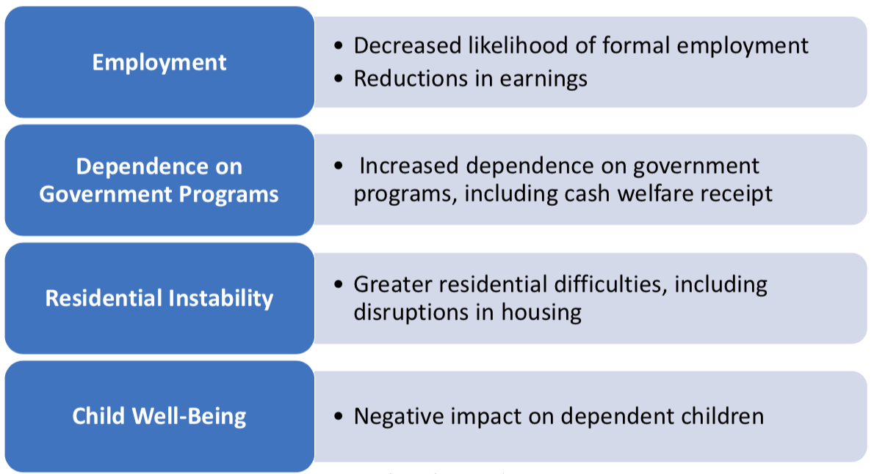
Notes:
Add a case study or class simulation to encourage discussion and apply lessons.

Slide 22
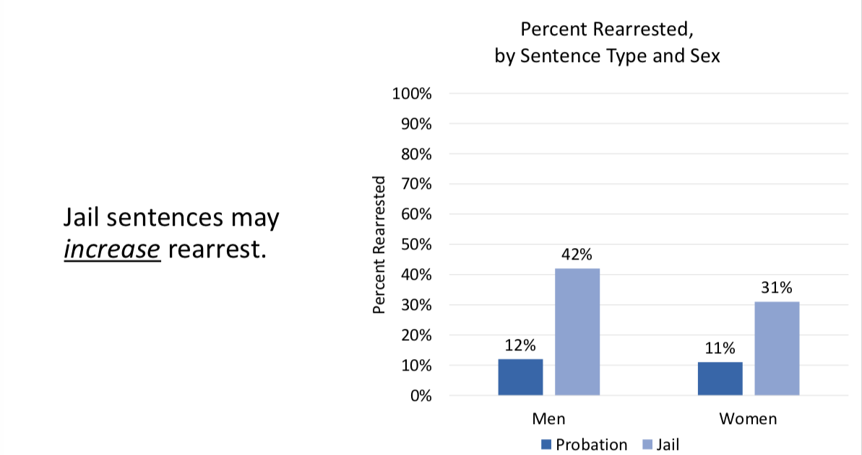
Notes:
Summarize presentation content by restating the important points from the lessons.
What do you want the audience to remember when they leave your presentation?

Slide 23
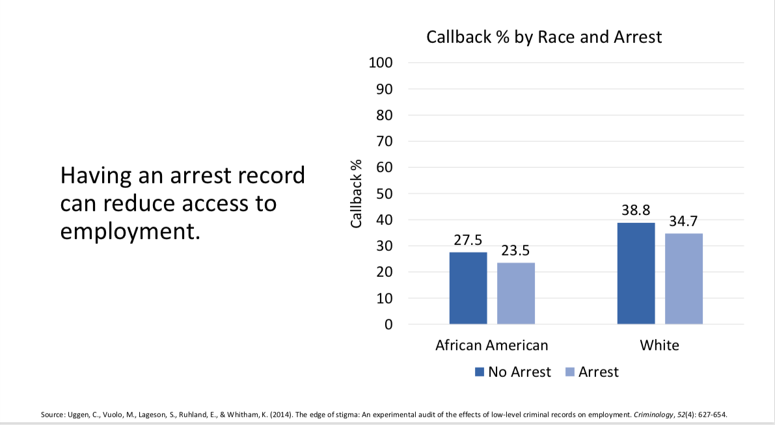
Notes:
Summarize presentation content by restating the important points from the lessons.
What do you want the audience to remember when they leave your presentation?

Slide 24
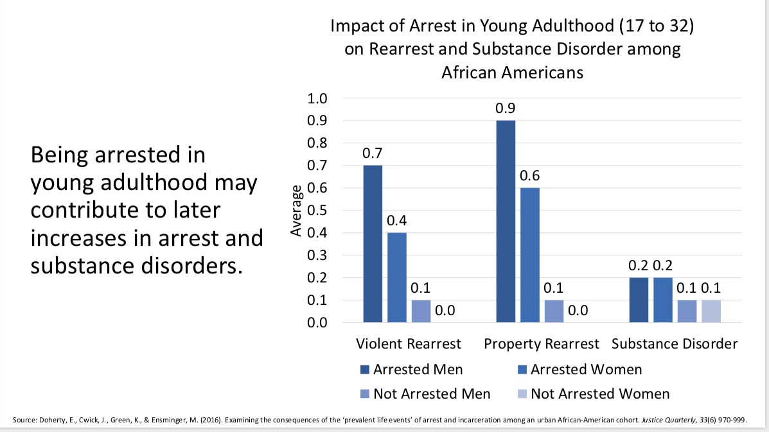

Slide 25
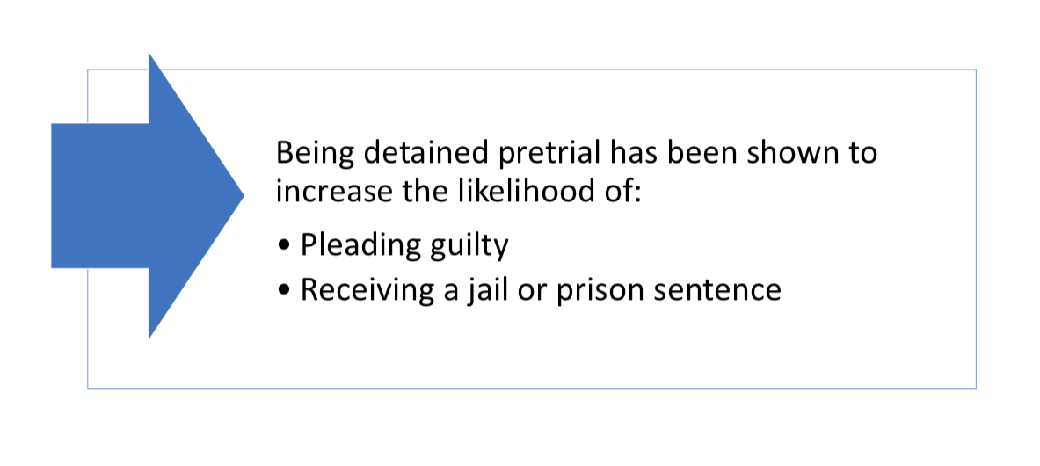

Slide 26
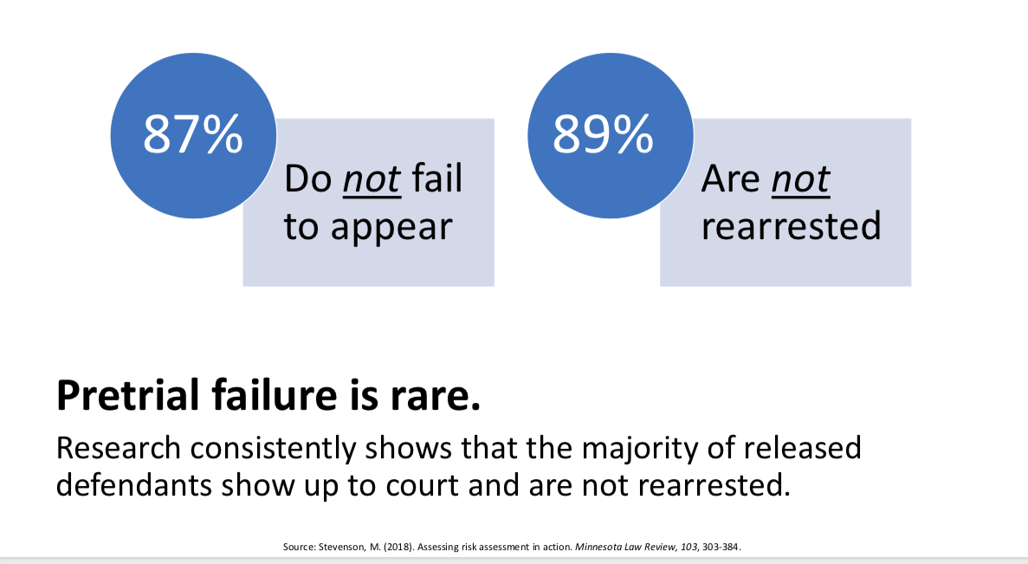
Notes:
Discuss outcomes of the case study or class simulation.
Cover best practices.

Slide 27
What Can Be Done to Reduce Admissions?
Bail reform
Alternatives to incarceration — substance use treatment:
Alternatives to incarceration — mental health treatment
End direct filing of minors
Maintaining judicial discretion
Blueprint for Smart Justice Michigan © 2018 AMERICAN CIVIL LIBERTIES UNION

Slide 28
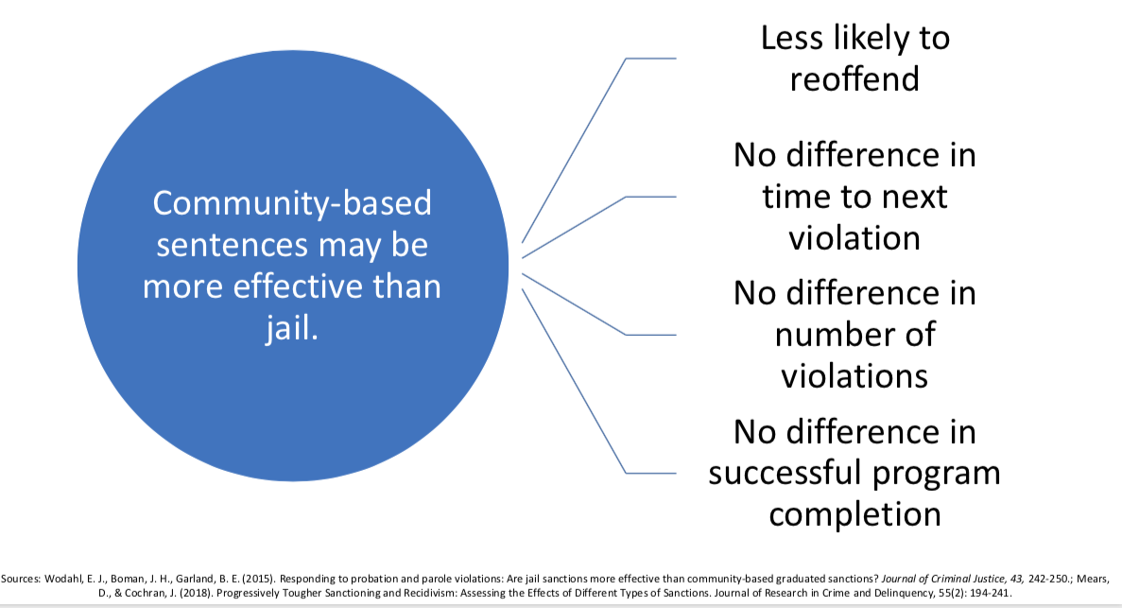

Slide 29


Slide 30
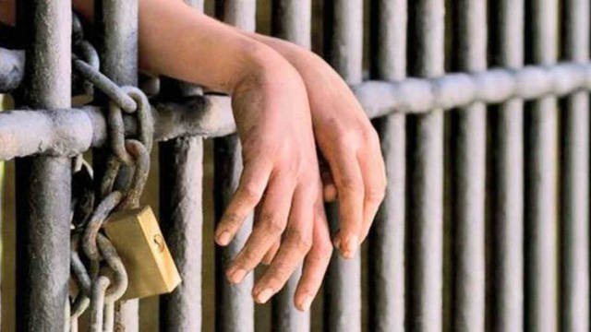

Slide 31
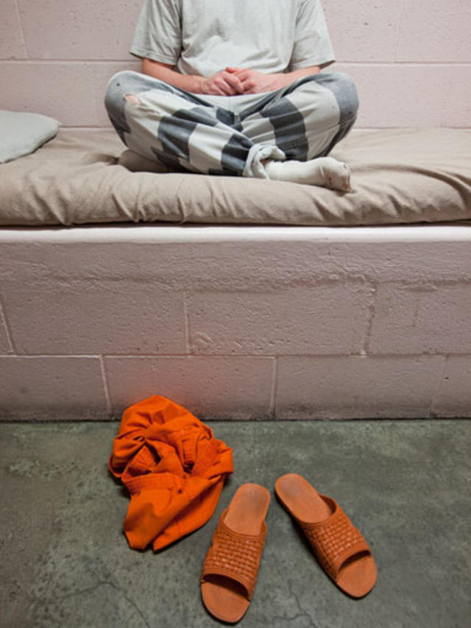

Slide 32
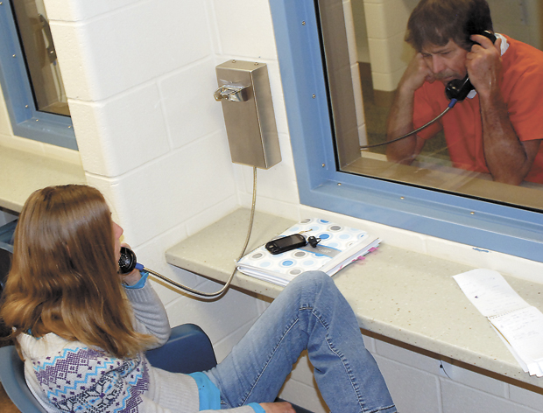

Slide 33
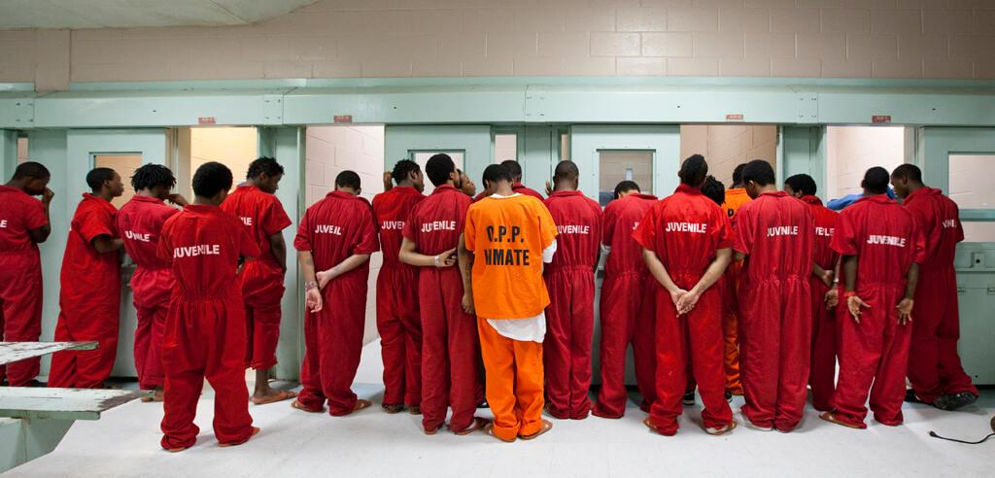

Slide 34
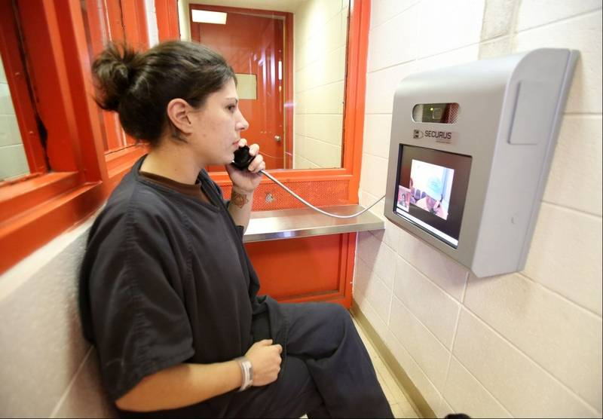

Slide 35
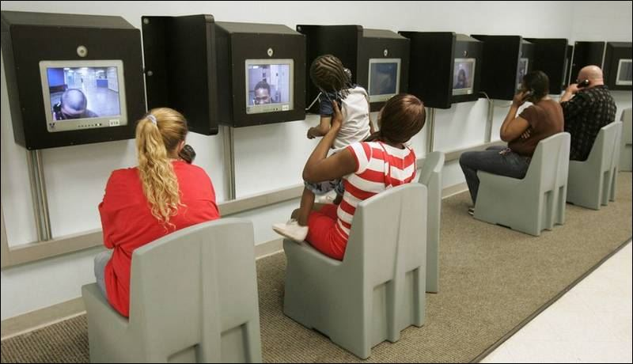

Slide 36
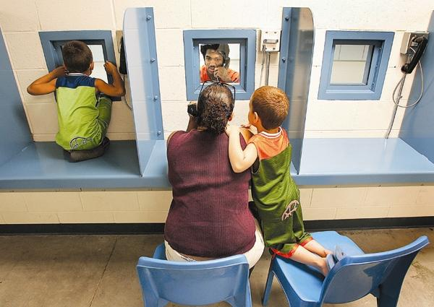

Slide 37
Questions? Contact BDAI at: bdai.org@gmail.com or stop by and talk to us after the discussion.

